Slide 1

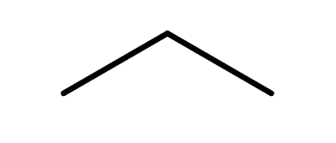

CARD 01 ―
PROPANE
(C₃H₈)
“THE SIMPLE SKELETON”
1. MOLECULAR FORMULA
2. LEWIS STRUCTURE
H
H
H
C₃H₈
H
C
C
C
H
3 C + 8 H = 11 atoms
H
H
H
3. CONDENSED STRUCTURAL FORMULA
4. BOND-LINE FORMULA
CH₃CH₂CH₃
CARBON TETRAVALENCY
“Each carbon forms four bonds, giving propane its stable three-carbon chain.”
VERIFICATION STRIP
atom count verified
valence checked
bond order checked
same connectivity confirmed
ChE Connection: LPG and Fuel Processing

Slide 2
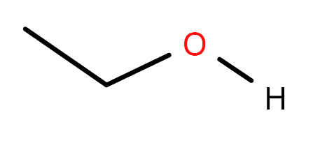
CARD 02 ―
ETHANOL
(C₂H₆O)
“FIRST HETEROATOM”
1. MOLECULAR FORMULA
2. LEWIS STRUCTURE
H
H
C₂H₆O
H
C
C
.
.
O
H
.
.
2 C + 6 H + 1 O = 9 atoms
H
H
3. CONDENSED STRUCTURAL FORMULA
4. BOND-LINE FORMULA
CH₃CH₂OH
Ethanol features an oxygen atom that forms two single bonds and holds two lone pairs, while its –OH group signifies the alcohol functional group.
VERIFICATION STRIP
atom count verified
valence checked
bond order checked
same connectivity confirmed
ChE Connection: Fermentation, Distillation, Solvents, and Biofuels

Slide 3
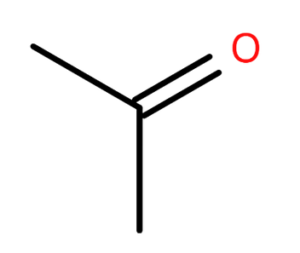
CARD 03 ―
ACETONE
(C₃H₆O)
(propan-2-one)
“THE CARBONYL CONNECTION”
1. MOLECULAR FORMULA
2. LEWIS STRUCTURE
H
.
.
O
.
.
H
C₃H₆O
H
C
C
C
H
3 C + 6 H + 1 O = 10 atoms
H
H
3. CONDENSED STRUCTURAL FORMULA
4. BOND-LINE FORMULA
CH₃COCH₃
CH₃C(=O)CH₃
This arrangement identifies acetone as a ketone and distinguishes its structure from ethanol, which contains a hydroxyl group (–OH).
VERIFICATION STRIP
atom count verified
bond order checked
valence checked
same connectivity confirmed
ChE Connection: Solvents, Chemical Processing, and Industrial Cleaning

Slide 4
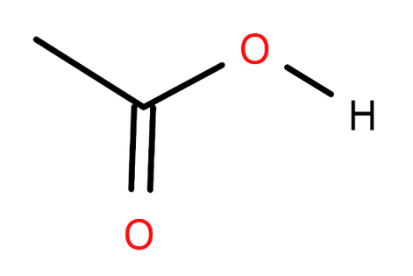
CARD 04 ―
ACETIC ACID
(C₂H₄O₂)
(ethanoic acid)
“THE ACIDIC O”
1. MOLECULAR FORMULA
2. LEWIS STRUCTURE
H
.
.
O
.
C₂H₄O₂
.
H
C
C
H
2 C + 4 H + 2 O = 8 atoms
.
O
.
.
.
H
3. CONDENSED STRUCTURAL FORMULA
4. BOND-LINE FORMULA
CH₃COOH
CH₃C(=O)OH
Acetic acid contains a carboxyl group (–COOH), which combines a carbonyl group (C=O) and a hydroxyl group (–OH) on the same carbon atom.
VERIFICATION STRIP
atom count verified
bond order checked
valence checked
same connectivity confirmed
ChE Connection: Food Processing, Fermentation, and Chemical Production

Slide 5
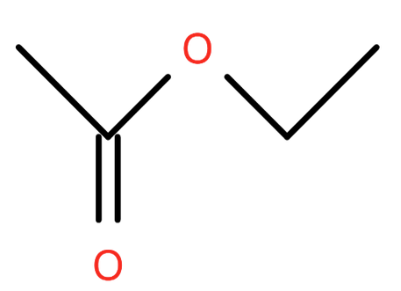
CARD 05 ―
ETHYL ACETATE
(C₄H₈O₂)
(ethyl ethanoate)
“THE ESTER CONNECTION”
1. MOLECULAR FORMULA
2. LEWIS STRUCTURE
H
.
.
O
H
H
C₄H₈O₂
.
.
.
.
H
C
C
O
C
C
H
.
.
4 C + 8 H + 2 O = 14 atoms
H
H
H
3. CONDENSED STRUCTURAL FORMULA
4. BOND-LINE FORMULA
CH₃COOCH₂CH₃
CH₃C(=O)OCH₂CH₃
Ethyl acetate contains the ester functional group. Esters have a carbonyl carbon bonded to another oxygen, which connects to a carbon group.
VERIFICATION STRIP
atom count verified
bond order checked
valence checked
same connectivity confirmed
ChE Connection: Solvent Extraction, Coatings, Inks, and Adhesives

Slide 6
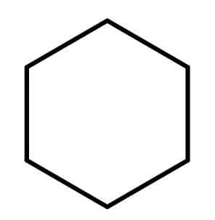
CARD 06 ―
CYCLOHEXANE
(C₆H₁₂)
“THE FIRST RING”
1. MOLECULAR FORMULA
2. LEWIS STRUCTURE
H
H
C
C₆H₁₂
H
H
H
C
C
H
6 C + 12 H = 18 atoms
H
C
C
H
H
H
C
H
H
3. CONDENSED STRUCTURAL FORMULA
4. BOND-LINE FORMULA
(CH₂)₆
Cyclohexane is a cyclic alkane consisting of six carbon atoms linked in a ring with single bonds. Each carbon atom is bonded to two neighboring carbons and two hydrogen atoms.
VERIFICATION STRIP
atom count verified
valence checked
bond order checked
same connectivity confirmed
ChE Connection: Petroleum Processing, Nylon Production, and Industrial Feedstocks

Slide 7
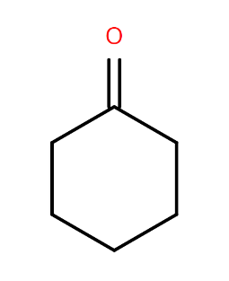
CARD 07 ―
CYCLOHEXANONE
(C₆H₁₀O)
“THE CARBONYL IN A RING”
1. MOLECULAR FORMULA
2. LEWIS STRUCTURE
.
.
O
.
.
C₆H₁₀O
C
H
C
C
H
H
H
6 C + 10 H + 1 O = 17 atoms
H
H
H
C
C
C
H
H
H
3. CONDENSED STRUCTURAL FORMULA
4. BOND-LINE FORMULA
O
(CH₂​)₅​CO
Cyclohexanone is a six-carbon cyclic ketone with a carbonyl group formed by a double bond between one ring carbon and oxygen, distinguishing it from cyclohexane.
VERIFICATION STRIP
atom count verified
valence checked
bond order checked
same connectivity confirmed
ChE Connection: Nylon Intermediates, Solvents, and Chemical Manufacturing

Slide 8
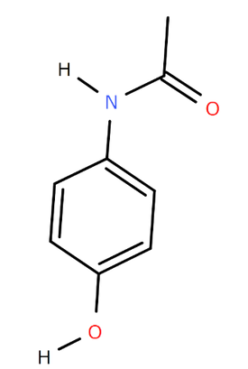
CARD 08 ―
ACETAMINOPHEN
(C₈H₉NO₂)
(paracetamol)
“THE AROMATIC AMIDE”
1. MOLECULAR FORMULA
2. LEWIS STRUCTURE
H
H
C
H
C₈H₉NO₂
H
.
.
C
N
O
.
.
.
.
C
H
H
C
C
8 C + 9 H + 1 N + 2 O = 20 atoms
H
C
C
H
C
.
O
.
.
H
.
3. CONDENSED STRUCTURAL FORMULA
4. BOND-LINE FORMULA
HO–C₆H₄–NHCOCH₃
VERIFICATION STRIP
atom count verified
bond order checked
valence checked
same connectivity confirmed
ChE Connection: Pharmaceutical Manufacturing and Quality Control

Slide 9
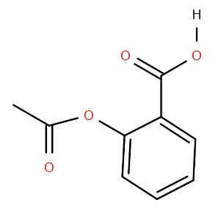
CARD 09 ―
ASPIRIN
(C₉H₈O₄)
(acetylsalicylic acid)
“TWO FUNCTIONAL GROUPS, ONE RING”
1. MOLECULAR FORMULA
2. LEWIS STRUCTURE
H
.
.
.
.
O
O
.
.
.
C
.
C₉H₈O₄
H
C
C
.
.
H
O
C
.
.
C
C
9 C + 8 H + 4 O = 21 atoms
H
H
.
O
C
C
.
.
.
H
H
C
H
3. CONDENSED STRUCTURAL FORMULA
4. BOND-LINE FORMULA
C₆H₄(COOH)(OCOCH₃)
VERIFICATION STRIP
atom count verified
bond order checked
valence checked
same connectivity confirmed
ChE Connection: Pharmaceutical Production, Chemical Synthesis, and Quality Control

Slide 10
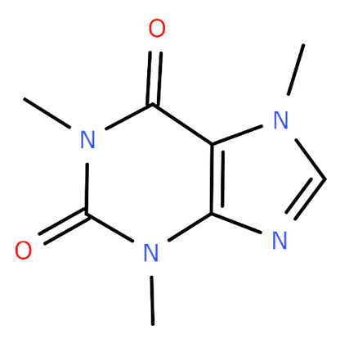
CARD 10 ―
CAFFEINE
(C₈H₁₀N₄O₂)
“THE FUSED-RING FINALE”
1. MOLECULAR FORMULA
2. LEWIS STRUCTURE
.
.
.
.
H
O
H
C
H
C
H
C₈H₁₀N₄O₂
H
N
C
.
C
.
.
N
H
.
C
H
8 C + 10 H + 4 N + 2 O = 24 atoms
C
C
N
.
.
.
.
.
O
N
.
.
.
H
C
H
H
3. CONDENSED STRUCTURAL FORMULA
4. BOND-LINE FORMULA
1,3,7-TRIMETHYLPURINE-2,6-DIONE
CH₃N1(CO)N3(CH₃)C4=C5(N7(CH₃)C6=N9)CO
Caffeine does not have a simple, universally used condensed structural formula comparable to CH₃CH₂OH.
VERIFICATION STRIP
atom count verified
valence checked
bond order checked
same connectivity confirmed
ChE Connection: Food and Beverage Processing, Extraction, and Quality Control

